Slide 1
Technology Time Off Calendar
Steps to Creating PTO Event in Outlook

Slide 2
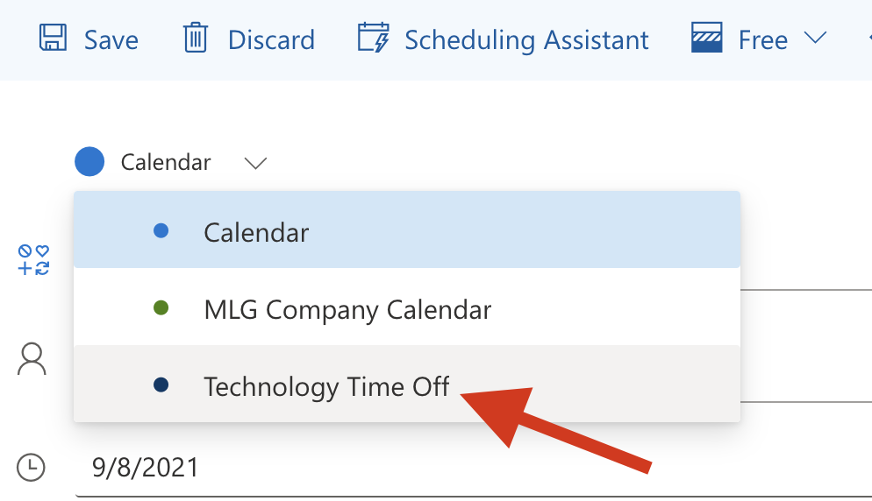
Selecting Calendar
Open a new event in Outlook
Select "Technology Time Off" calendar in the dropdown

Slide 3
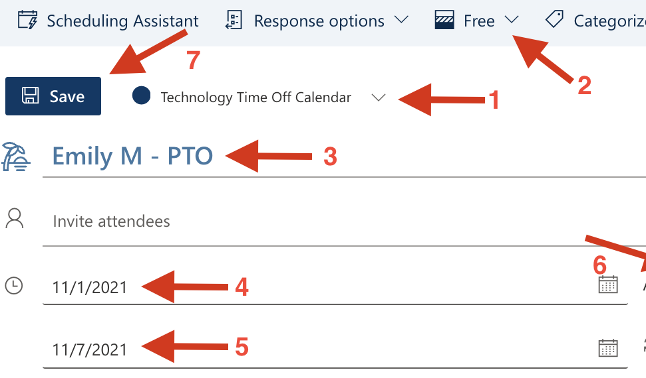
Creating Calendar Event (1+ Full Day) - Technology Time Off Calendar
Creating Calendar Invite (Tech/Shared Calendar):
Double check you are on the "Technology Time Off" calendar
Keep "Show As" = FREE
Enter Title (First Name, Last Initial – PTO)
Enter Start Date
Enter End Date
Keep "All Day" toggle on" (cut off from screenshot)
Save

Slide 4
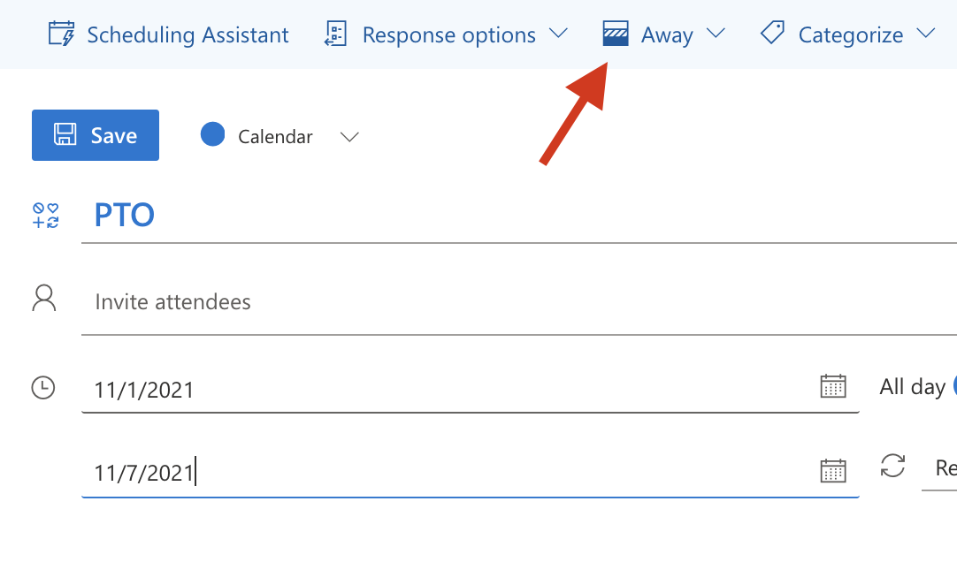
Creating Calendar Event (1+ Full Day) - Personal Work Calendar
Creating Calendar Invite (Personal/Work Calendar): On your personal work calendar, you will follow the same steps as the Tech Time Off slide, but have "Show As" be "Out of Office" or "Away"
Keep "Show As" = Out of Office
Enter Title
Enter Start Date
Enter End Date
Keep "All Day" toggle on
Save

Slide 5
Additional Notes
As a "best practice", please keep the Technology Time Off calendar checked off.
If you are out of office for a set amount of time in a day (ex: 1 hour, half day, etc.), please follow the same steps in slide 3 and 4, but do not include "All Day" swiped "on" and enter the start and end time (keep as "FREE").
If folks outside of Technology should be included on the event, please add as "Attendees" to the Technology Time Off calendar invite (where the event is marked as "FREE").
Do not add the Technology distro.

